Slide 1


EXPLORING
GREY’S ANATOMY
BY EMMY DOORE

Slide 2

Overview
What is Grey’s Anatomy?
Medical drama that first premiered in 2005 on ABC
Follows the surgical residency of a group of five interns and their superiors
As of early March 2024, there are 420 episodes and 19 seasons
Currently the 9th longest running scripted primetime tv series
Why Grey’s Anatomy?
I love the drama
Wanted to know if it was worth it to continue watching
Sources:
https://en.wikipedia.org/wiki/List_of_longest-running_scripted_American_primetime_television_series
https://en.wikipedia.org/wiki/List_of_Grey%27s_Anatomy_episodes#Series_overview

Slide 3





Technologies Used
Utilized BeautifulSoup and cloudscraper to webscrape IMDB and the Grey’s Anatomy wiki page on fandom.com
I was able to pull episode info as well as ratings, viewers, and medical notes for each episode.
Used to organize and clean the data I scraped.
All visuals were made in
Power BI.

Slide 4
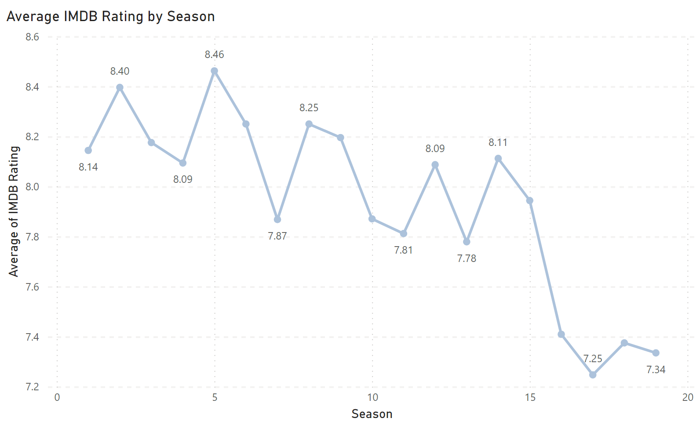
Ratings

Slide 5
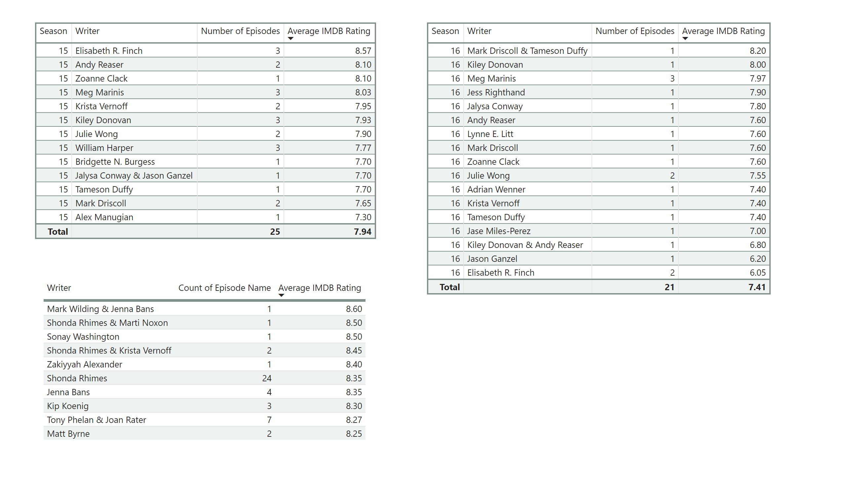

Writers

Slide 6
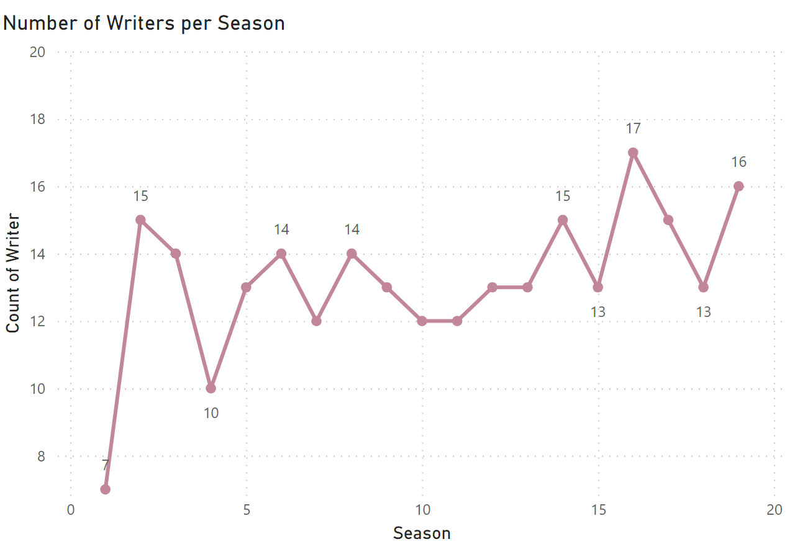
Writers

Slide 7





Ratings
T.R. Knight as George O’Malley
Katherine Hiegl as Izzy Stevens
Sandra Oh as Christina Yang
Ellen Pompeo as Meredith Grey
Justin Chambers as Alex Karev

Slide 8
Characters

Slide 9
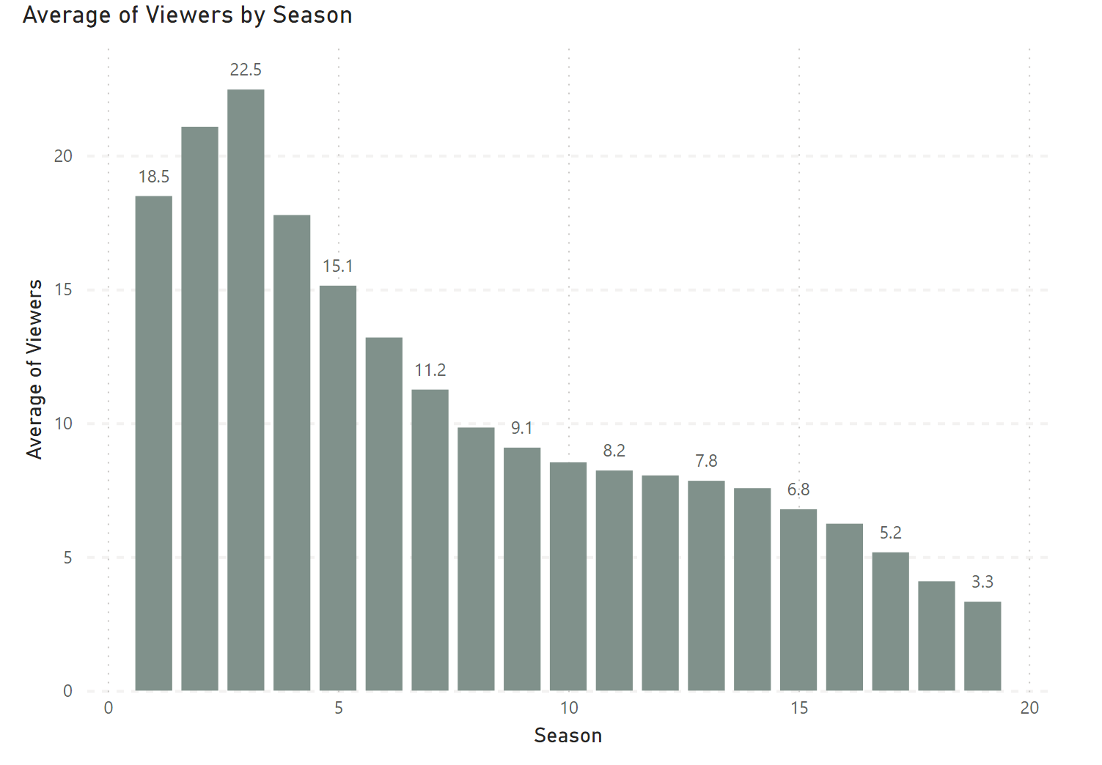
Viewers

Slide 10
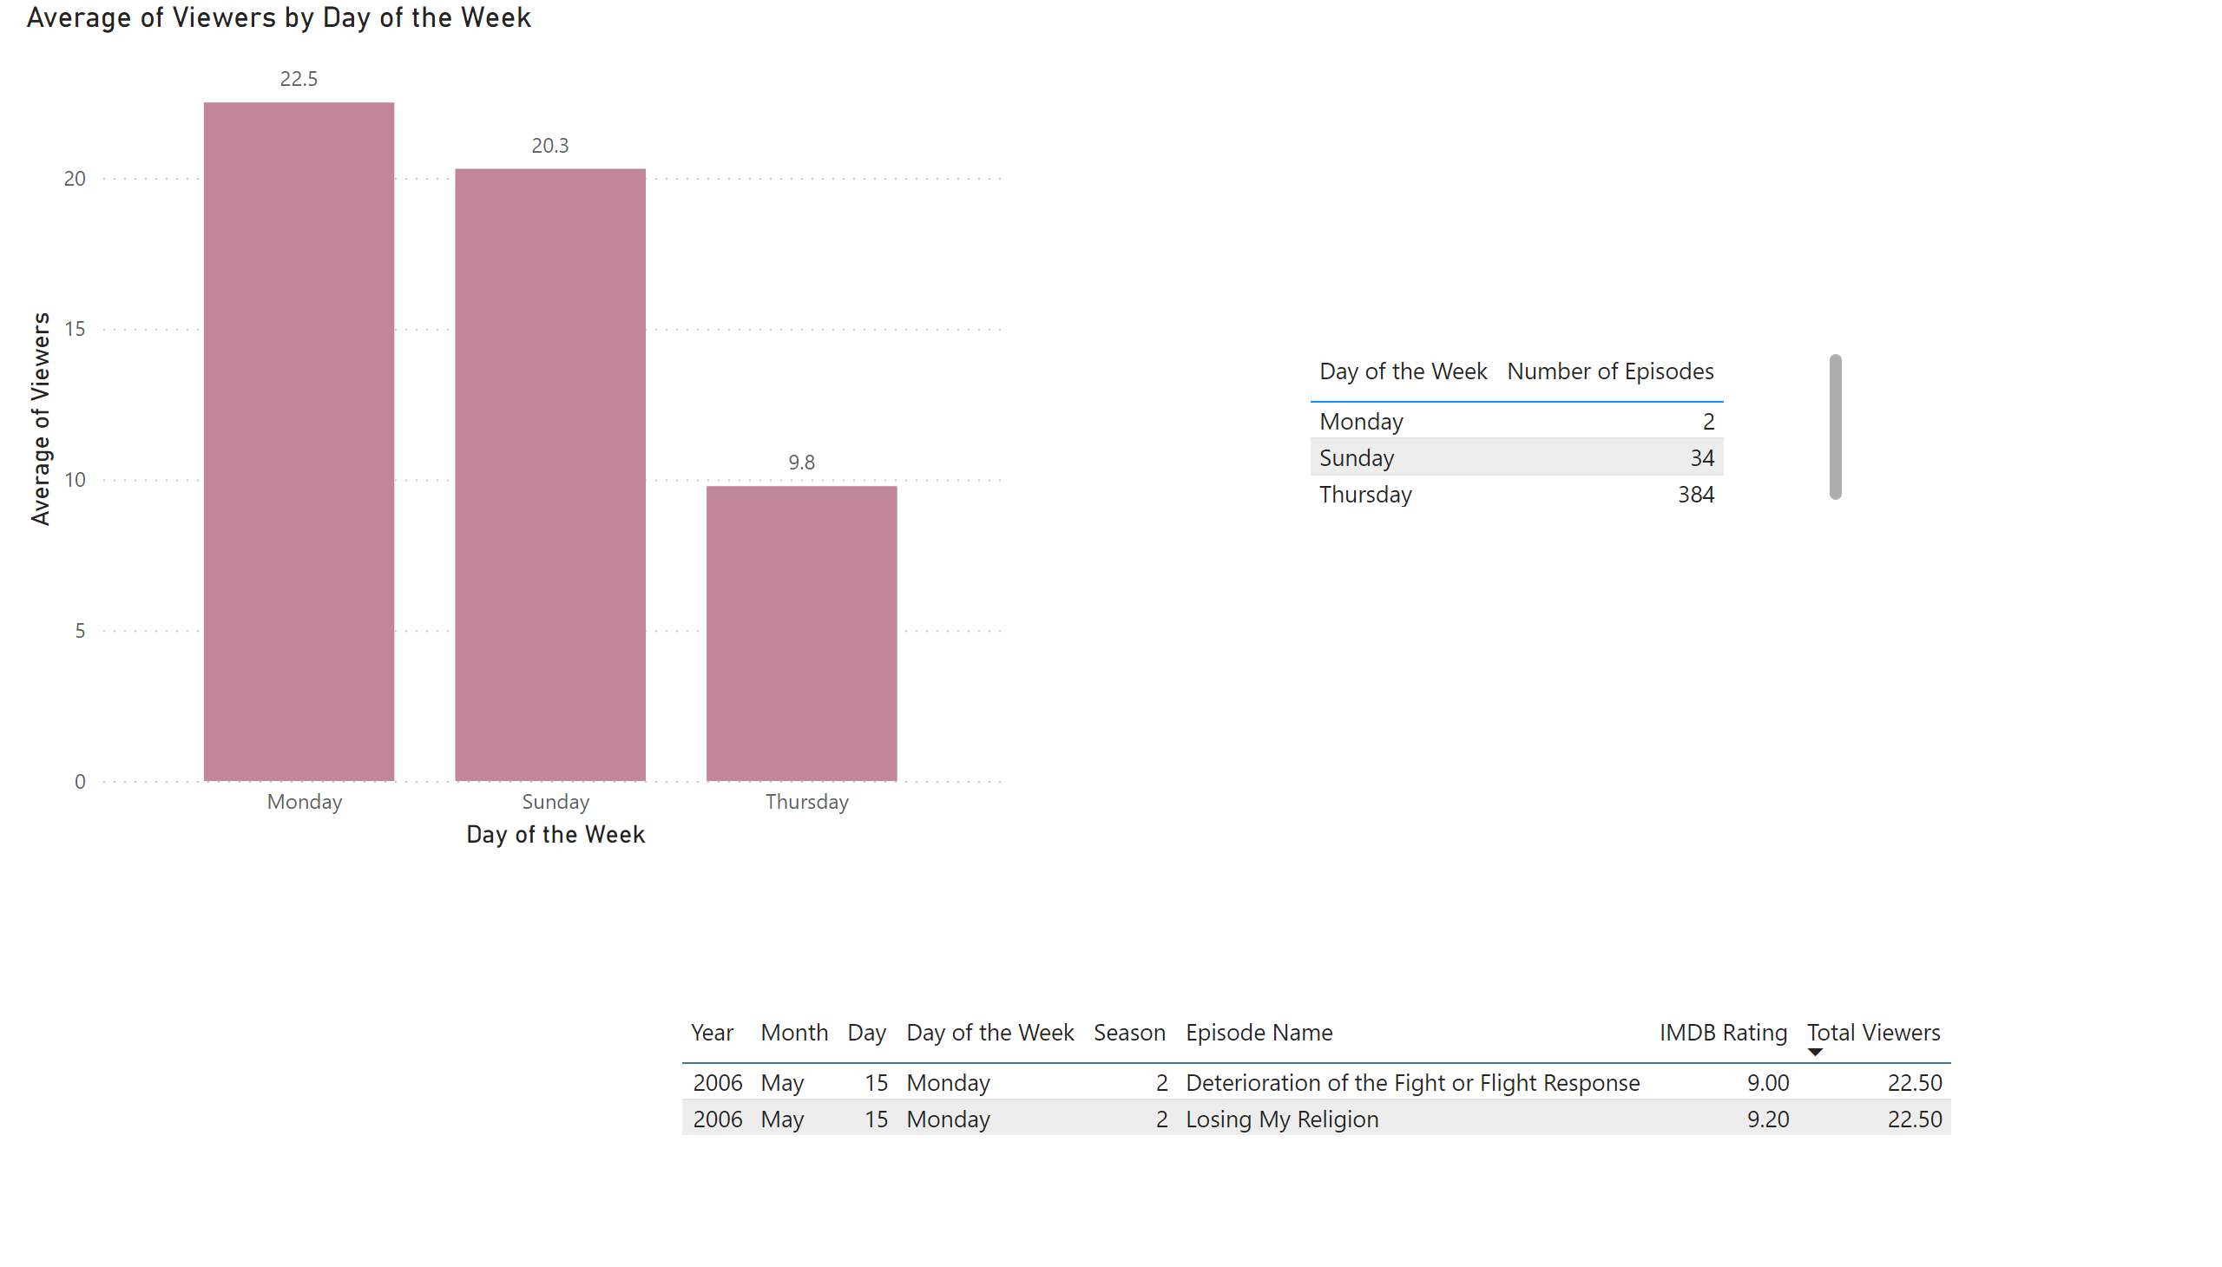
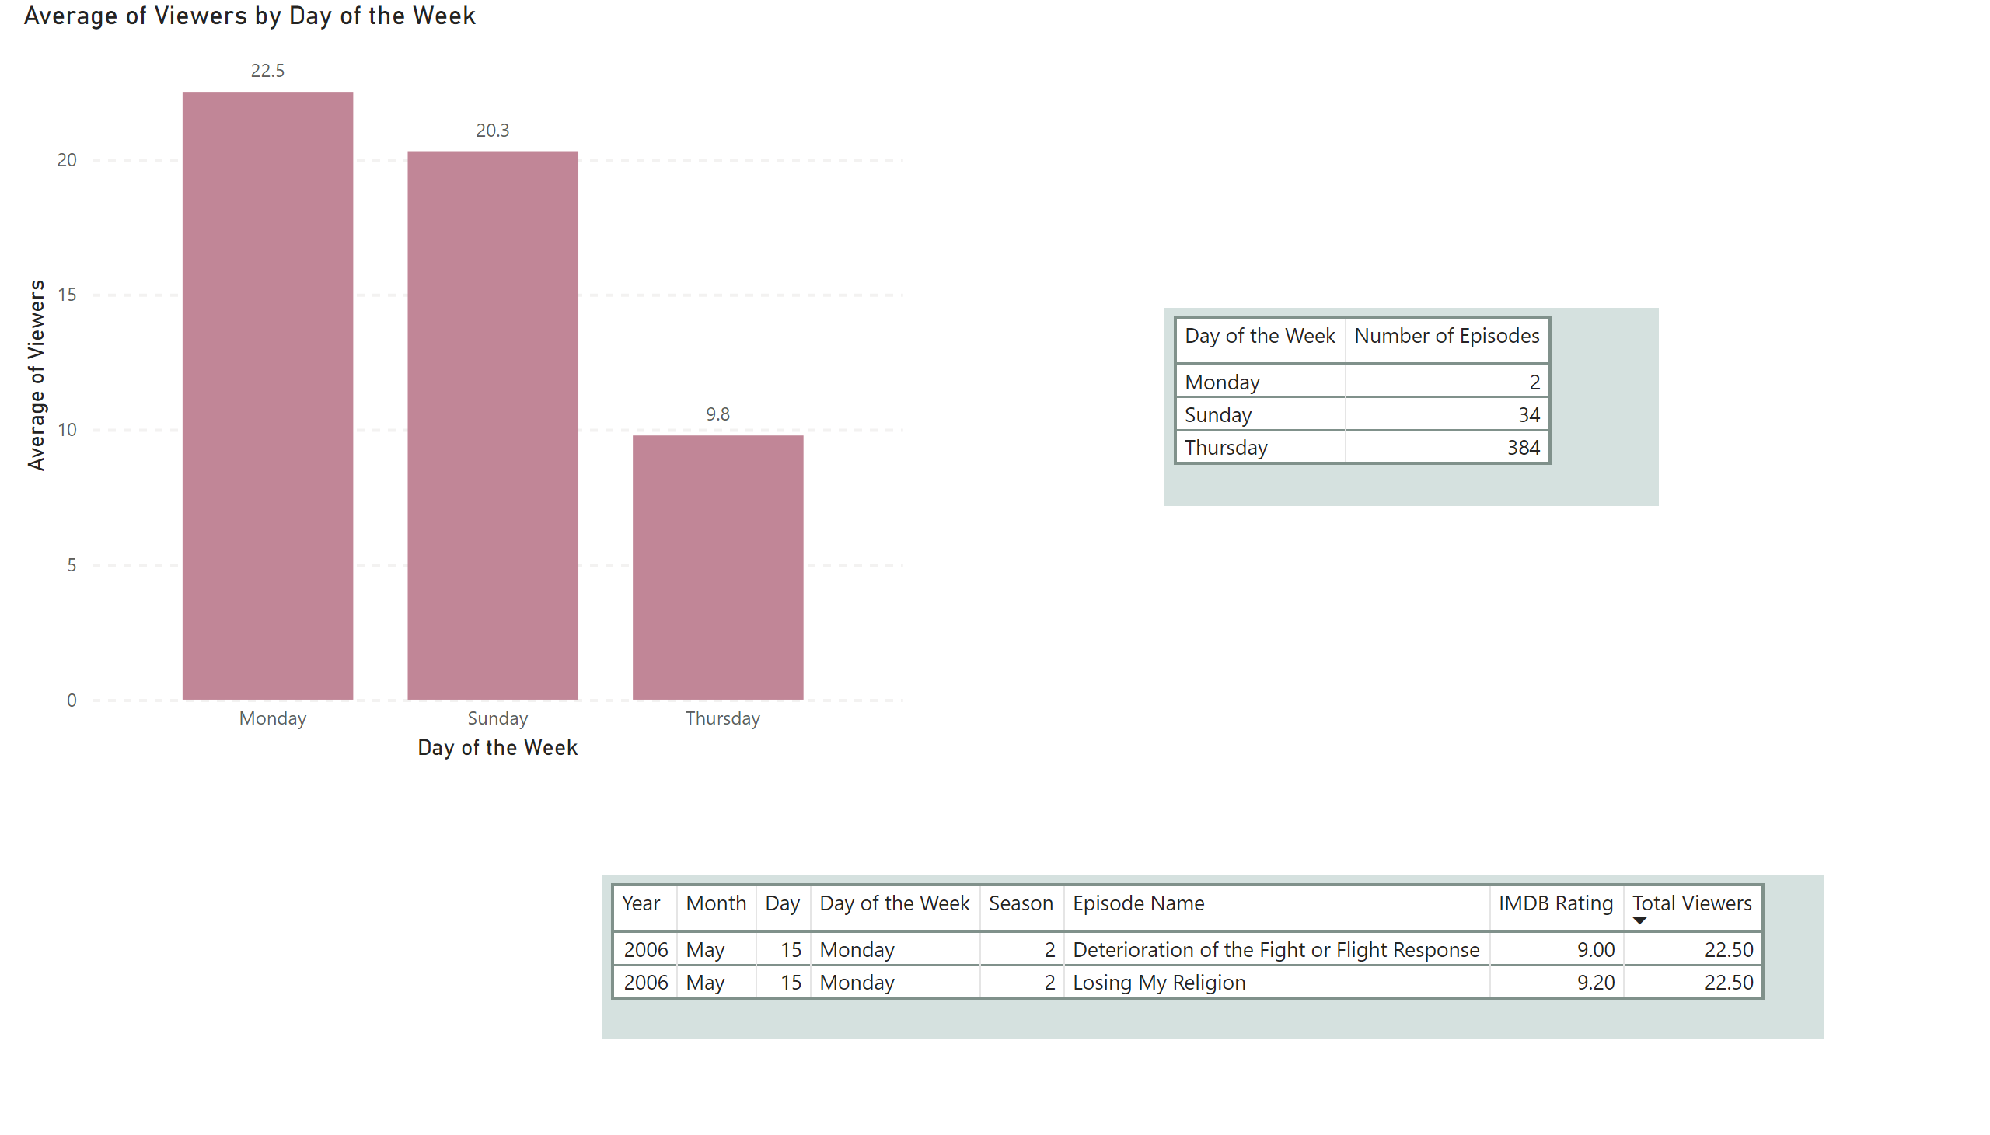
Viewers

Slide 11
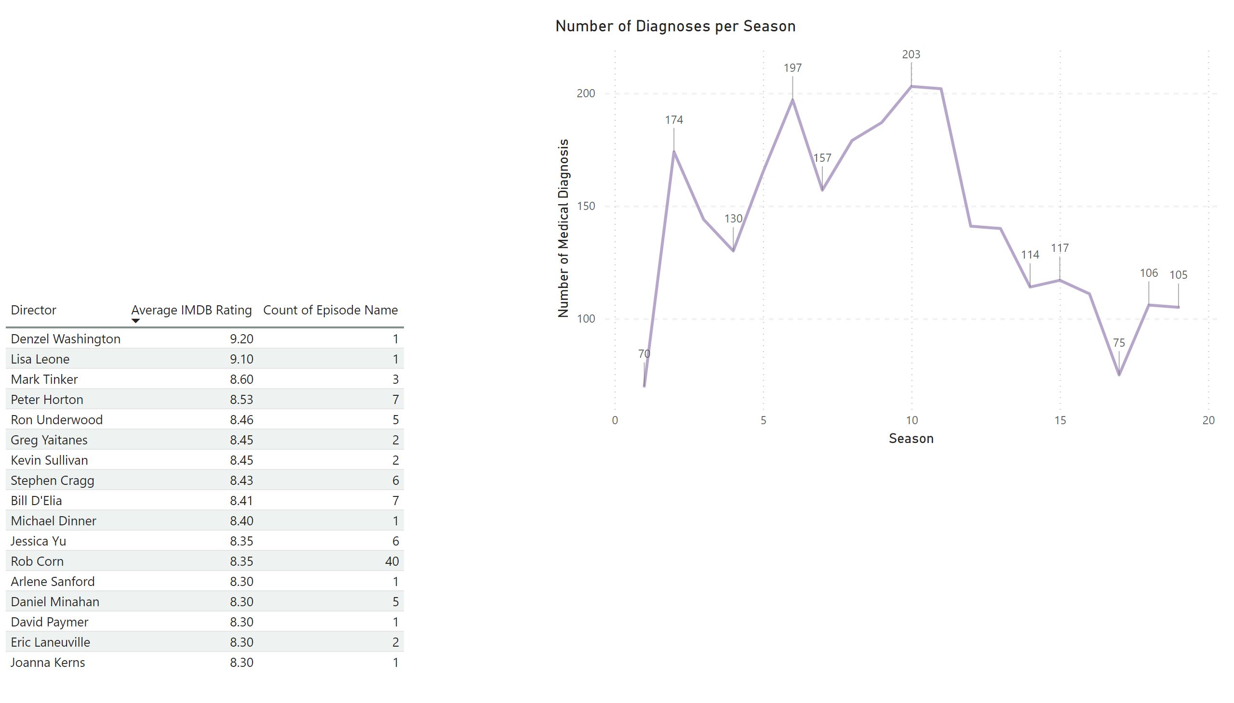
Medical Diagnoses
Aired 11/2020 – 06/2021
Notes:
Pulled every diagnosis per season
Season 11 had the most

Slide 12
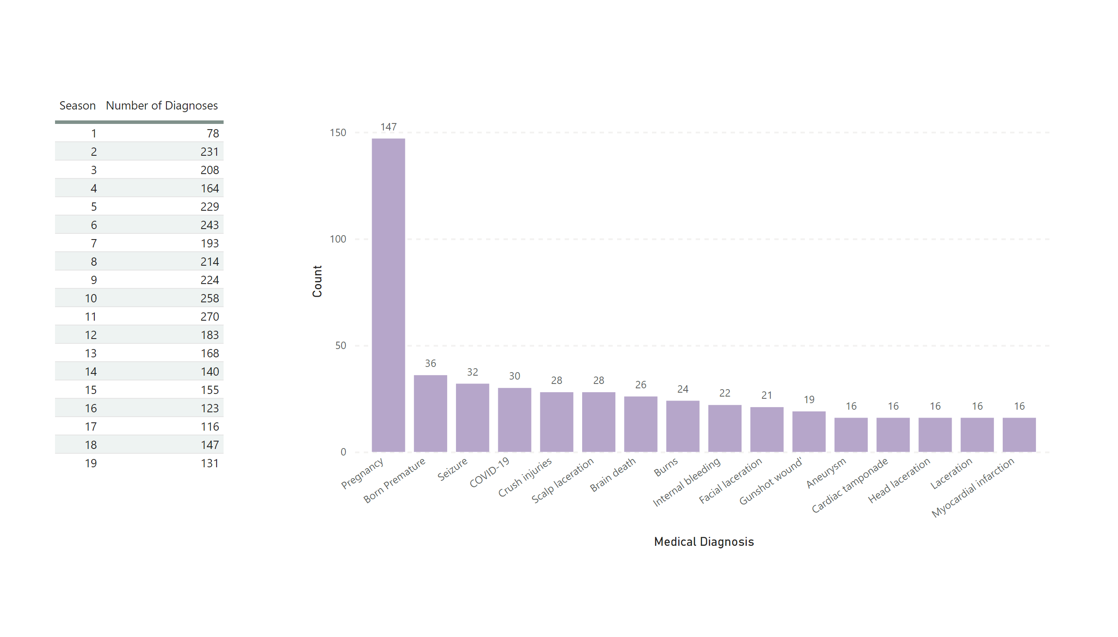
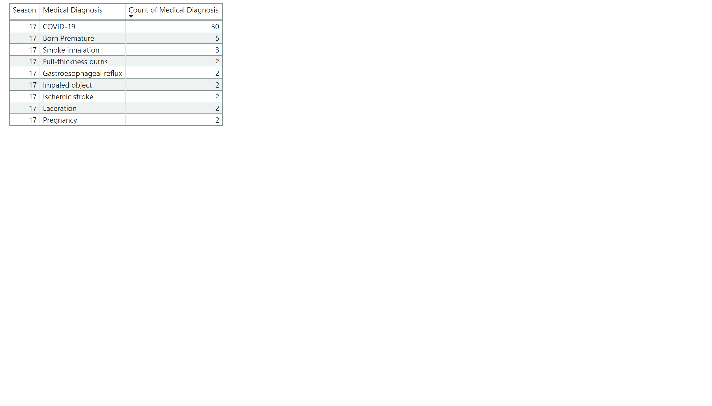
Medical Diagnoses
Notes:
Pulled every diagnosis per season
Season 11 had the most

Slide 13
Medical Diagnoses vs Ratings
Notes:
Pulled every diagnosis per season
Season 11 had the most

Slide 14
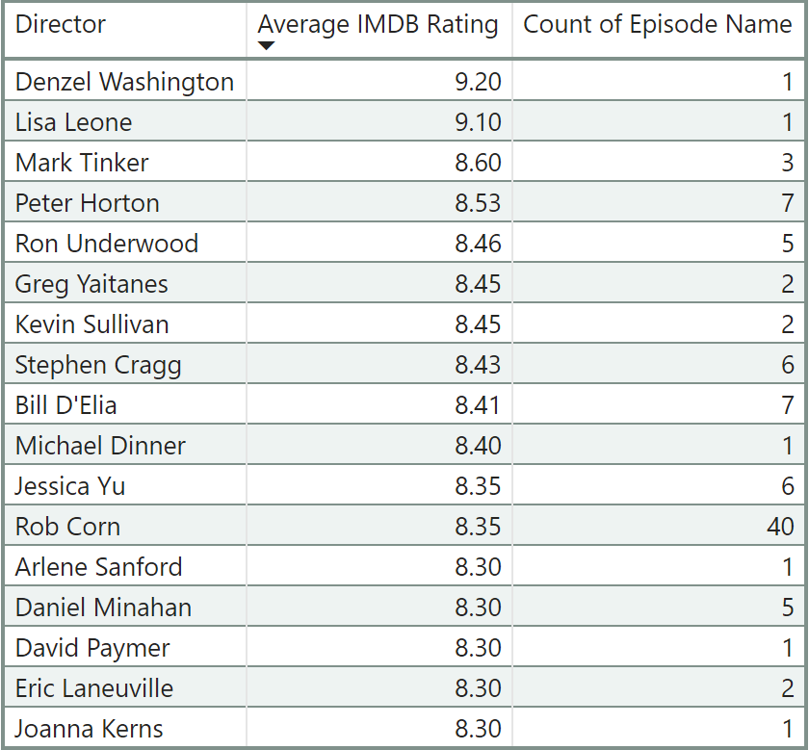
Interesting Fact
Notes:
Pulled every diagnosis per season
Season 11 had the most

Slide 15
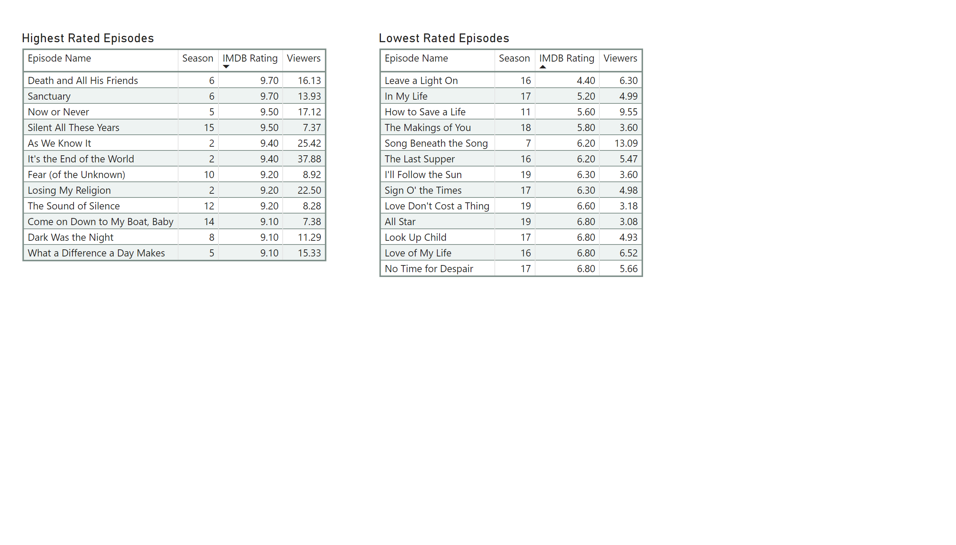
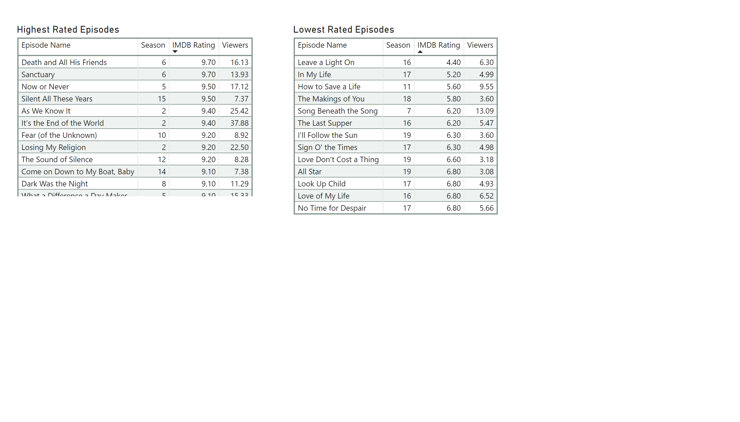
Will I give seasons 11-20 a chance?
Probably not…

